Slide 1
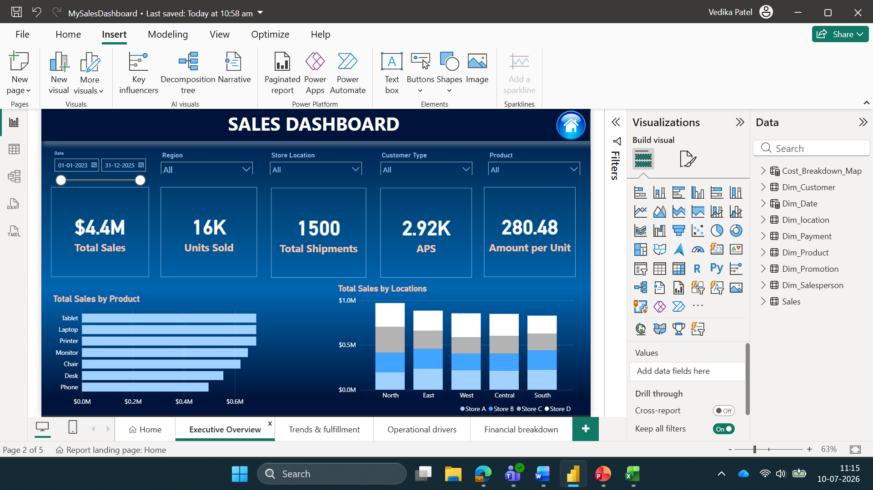
My Sales Dashboard
By Vedika Patel

Slide 2
Goal of my Project
To implement a Power BI based dashboard for an Online Product Sales Dataset.
The process comprised of the data pipeline:
1. Data extraction- already done
2. Data transformation- data cleaning, standardizing and joining tables
3. Service- connecting the tables to a dashboard and generating charts for relevant business metrics

Slide 3
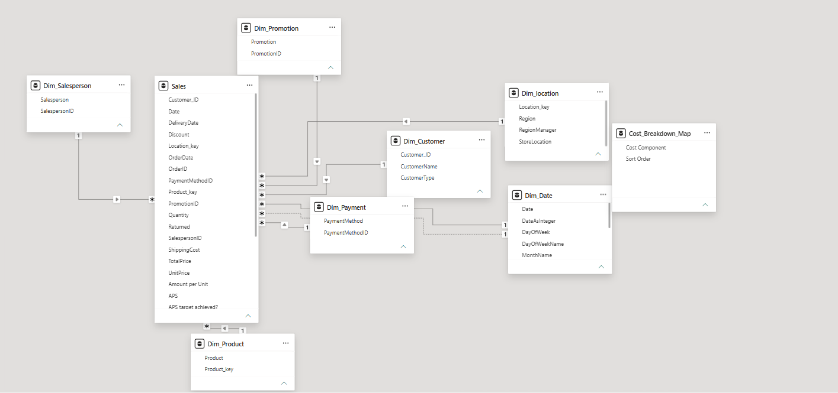
Tables and Relationships

Slide 4
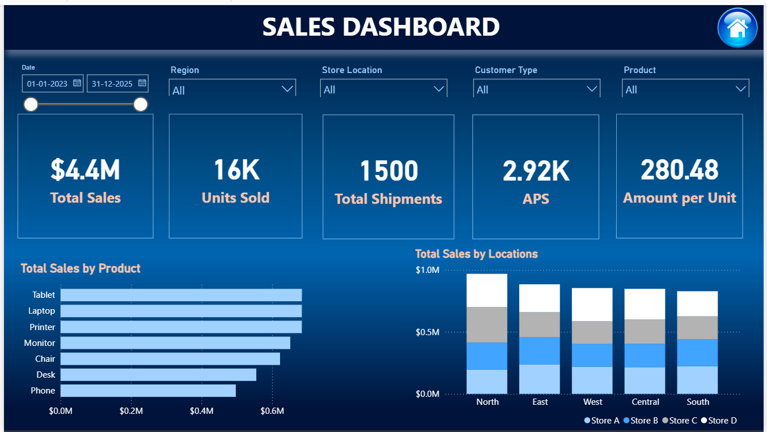
Overview Page

Slide 5
Important measures:
Total Sales- the sum of all product transactions before deductions
Units sold- total quantity of products sold by the company
Total Shipments- total number of batches of orders sent to customers
APS- the average revenue generated by a single processed shipment
Amount per unit- the average selling price of a singular product
Total sales by product- a clustered bar chart showing sales by product
Total sales by region and store- a stacked column chart showing sales by region and different stores.

Slide 6
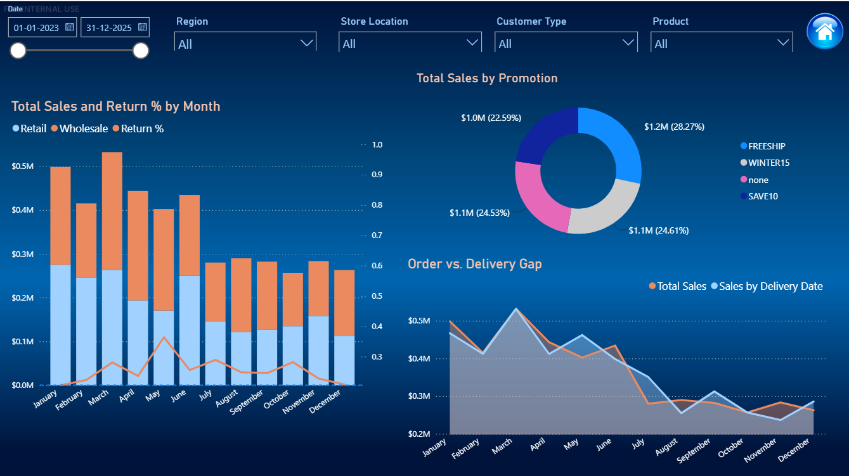
Trends and Fulfilment

Slide 7
Important measures:
Total sales and return % by month- It shows monthly revenue trends versus the percentage of sales lost to returns. Splitting by Retail and Wholesale is critical because wholesale buyers usually return items in bulk (due to damage or overstock), while retail returns are individual customer-driven.
Total sales by different promotions- It isolates how much revenue was driven by specific discount codes, seasonal events, or clearance campaigns versus standard full-price organic sales ("None"). This tells management which promotions actually drive volume and which ones just dilute profits.
Order vs Delivery gap- It highlights operational bottlenecks. If your "Sales by Order Date" is spiking but "Sales by Delivery Date" is lagging weeks behind, your warehouse or shipping partners are facing backlogs. And if it is the other way round then, it shows carryovers.

Slide 8
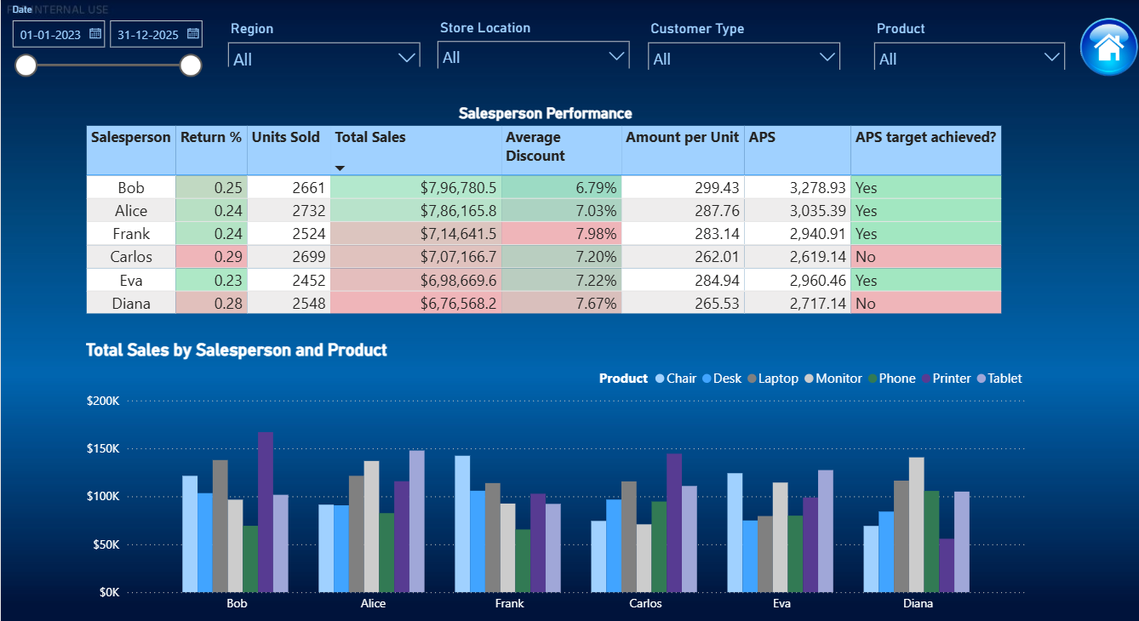
Operational Drivers

Slide 9
Important Measures:
Salesperson performance- We measure Total Sales and Units Sold alongside Return Rates and Average Discounts to spot margin erosion early. Crucially, we monitor APS-Average Price per Sale against their specific targets. This immediately highlights who is successfully driving high-value deals and hitting their strategic goals.
Total sales by Salesperson and Product- Clustered Column Chart breaks down Total Sales by both Salesperson and Product. By clustering product revenue directly under each rep's name, leadership can instantly see not just who is winning, but what they are winning with.

Slide 10
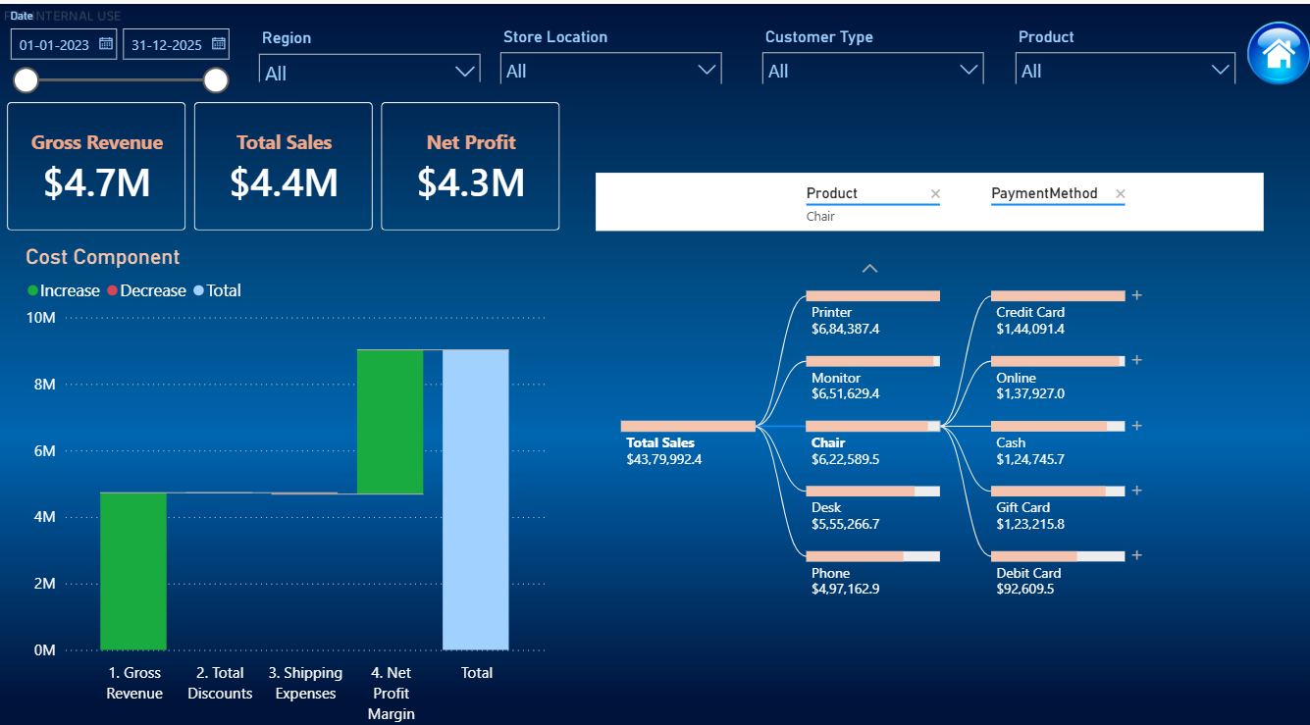
Financial Breakdown

Slide 11
Important Measures:
1. Gross Revenue- The total, unadjusted amount of money generated by all product and service sales before subtracting any expenses, discounts, or returns.
2. Net Profit- This is the remaining revenue left over after subtracting all operational costs, total discounts, shipping fees, taxes, and overhead expenses from Gross Revenue. It represents actual business profitability

Slide 12
Thank You!

